Slide 1
Experiments
RESEARCH
PLAN
08.21

Slide 2
说明
实验中的曲线与论文原图曲线颜色相同，方便对比（A2C除外）；
A2C是我自己新加的对比实验，主要用于产生DAC+PPO与DAC+A2C的对比，以及DAC+PPO & PPO自身和DAC+A2C & A2C自身的对比；

Slide 3
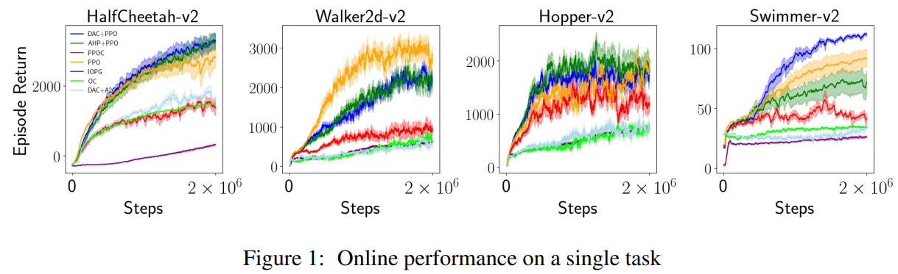
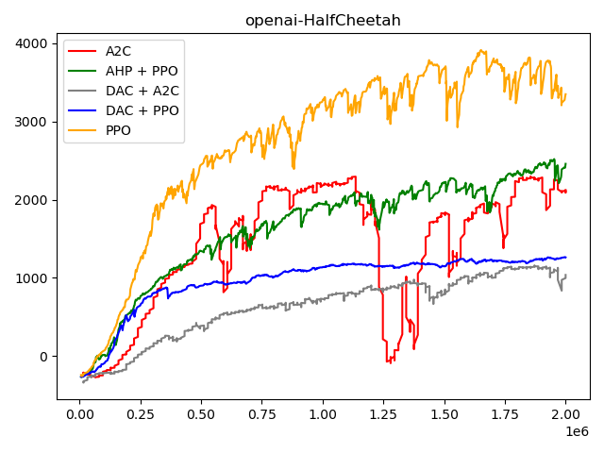
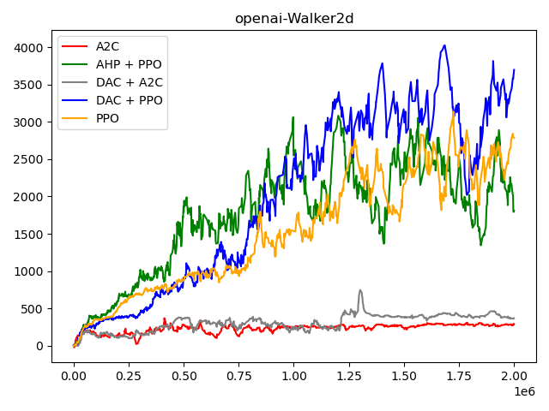
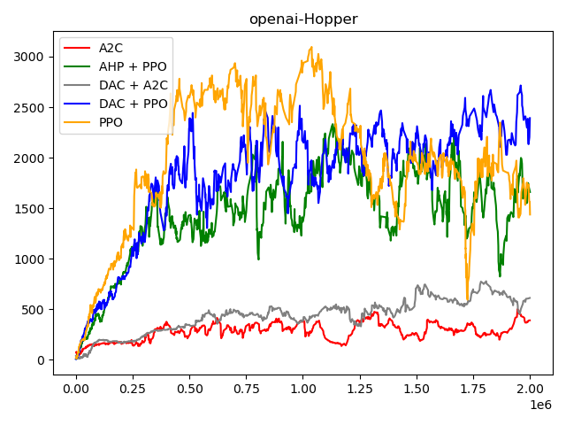
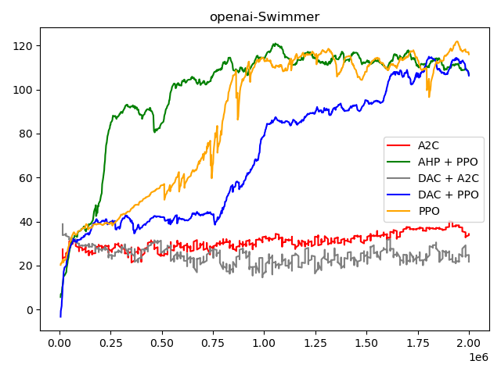
Single tasks

Slide 4
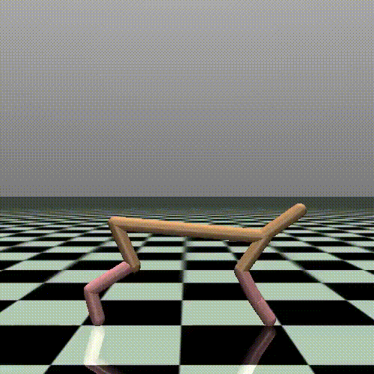
Single tasks - HalfCheetah

Slide 5
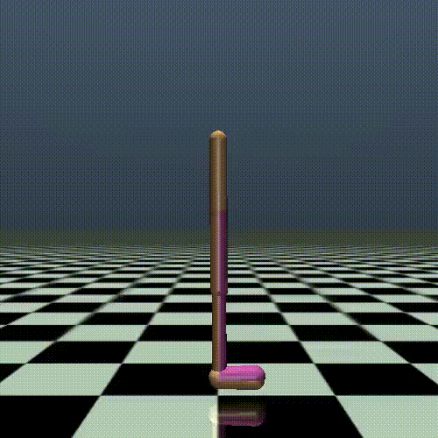
Single tasks – Walker2d

Slide 6
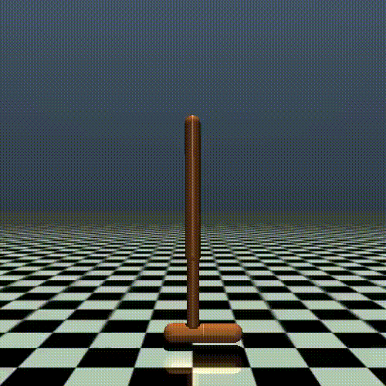
Single tasks - Hopper

Slide 7
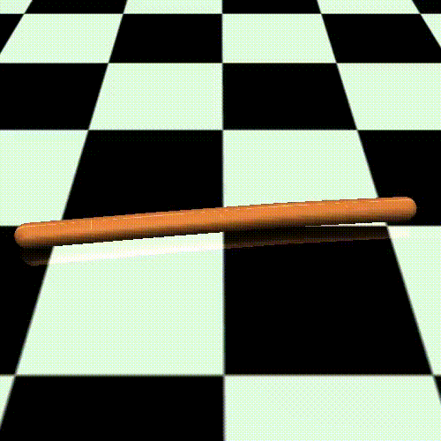
Single tasks - Swimmer

Slide 8
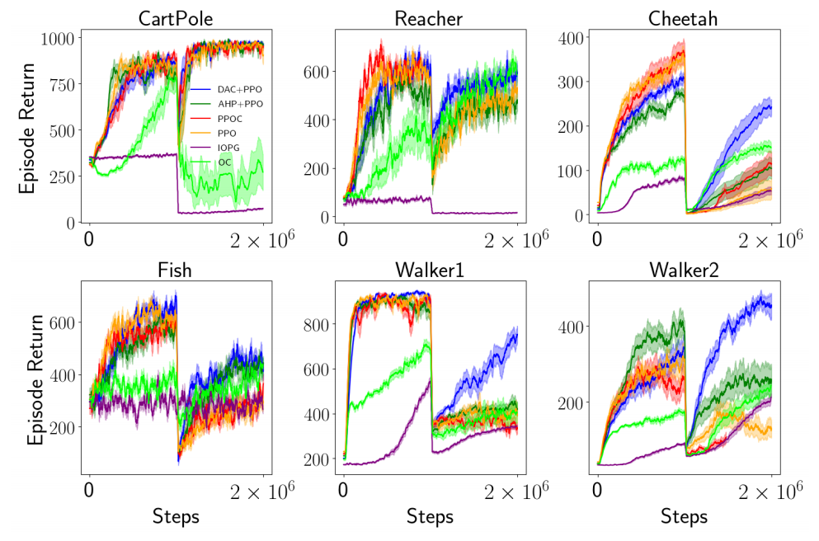
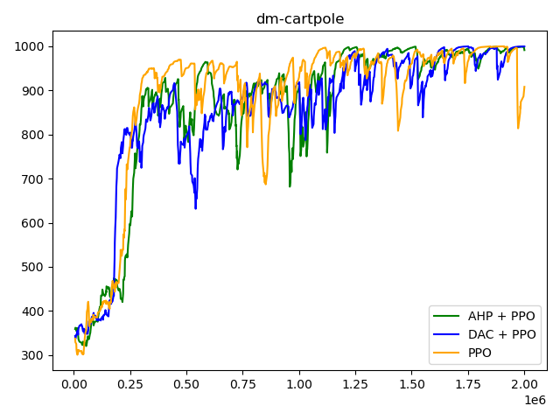
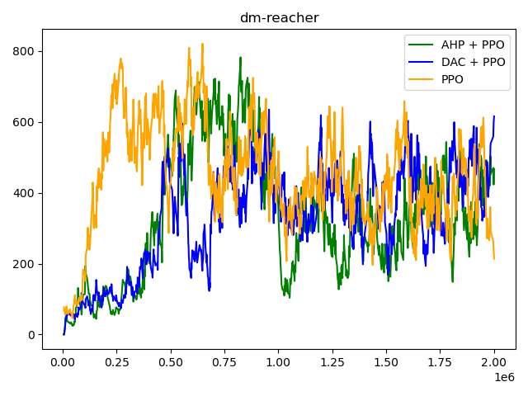
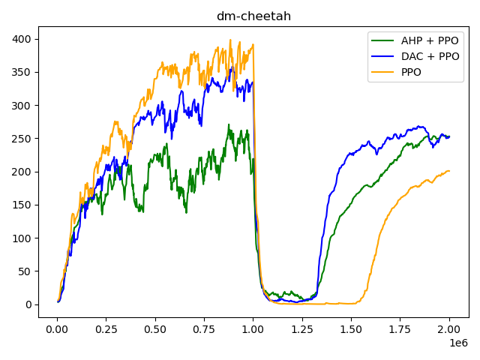
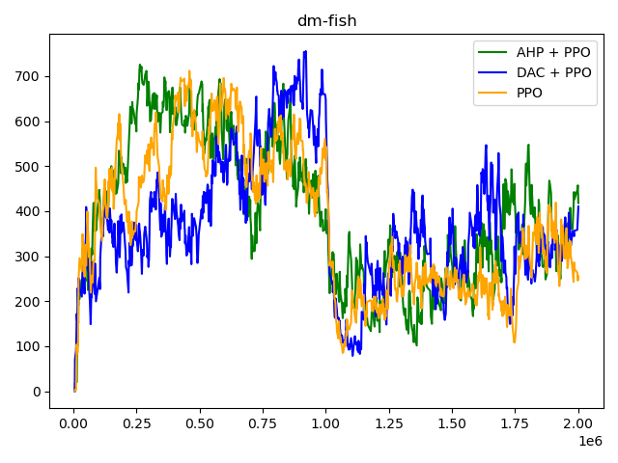
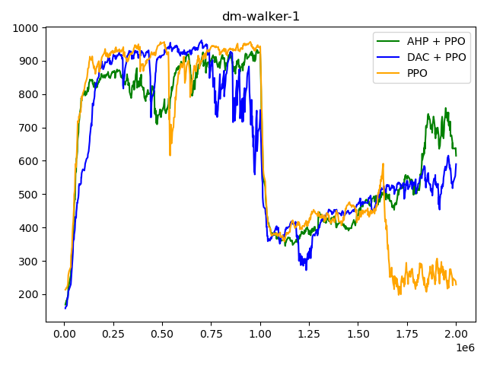
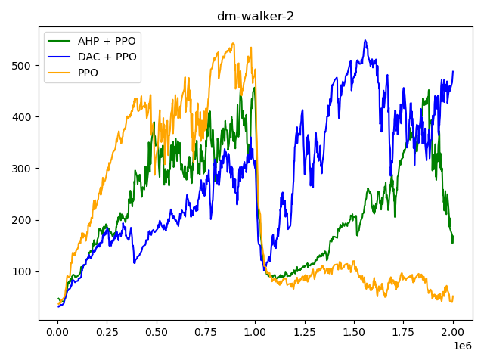
Transfer learning

Slide 9
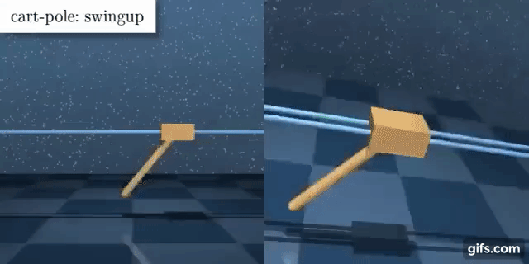
Transfer learning – Cartpole(balance, balance_sparse)

Slide 10
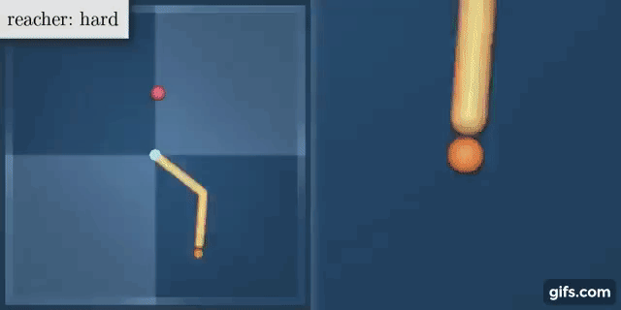
Transfer learning – Reacher(easy, hard)

Slide 11
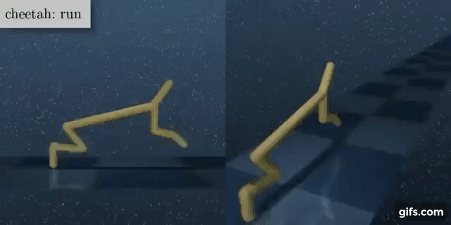
Transfer learning – Cheetah(run, backward)

Slide 12
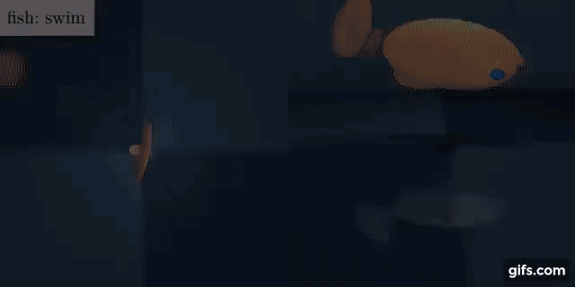
Transfer learning – Fish(upright, downleft)

Slide 13
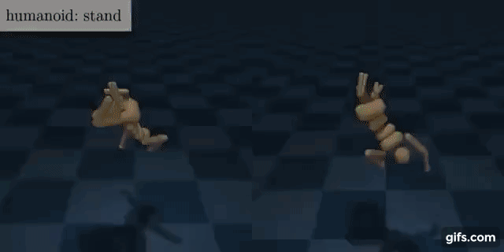
Transfer learning – Walker1(squat, stand)

Slide 14

Transfer learning – Walker2(walk, backward)

